Slide 1


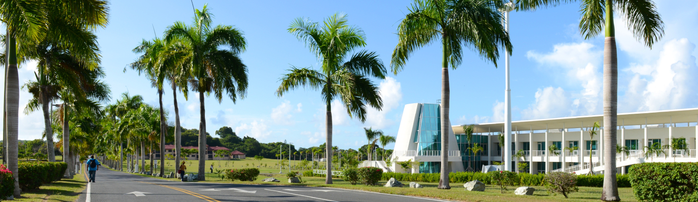

Artificial Intelligence in the Legal Arena:
Opportunities, Challenges, and Ethical Considerations
Dr. Ben C. Walter
Associate Professor of Mathematics
University of the Virgin Islands
https://bit.ly/4df8fAY
Office of the Territorial Public Defender
December 12, 2024

Slide 2
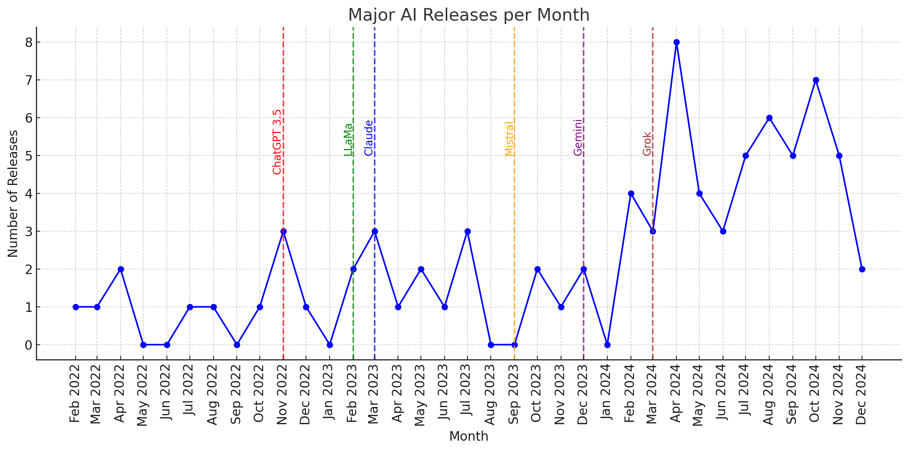
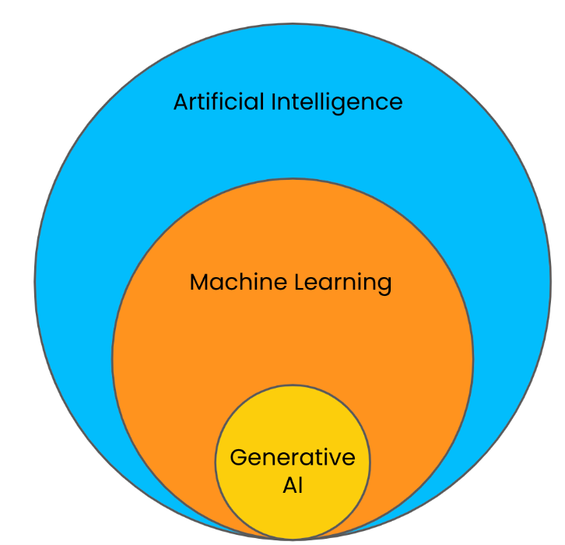
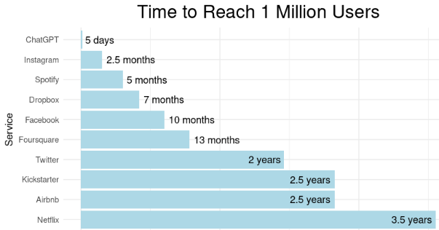
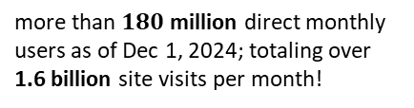
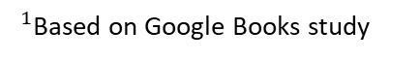
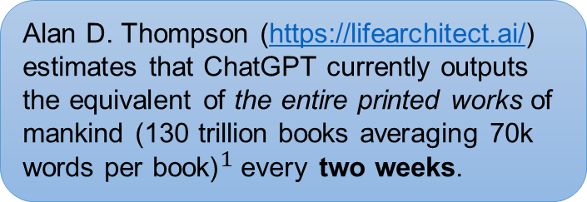
Growth of Generative Artificial Intelligence (Gen AI)
Generative AI involves machines creating
new output – text, images, or audio – without explicit instructions
more than $180$ million direct monthly users as of Dec 1, 2024; totaling over 1.6 billion site visits per month!
Data from https://nhlocal.github.io/AiTimeline/
Alan D. Thompson (https://lifearchitect.ai/) estimates that ChatGPT currently outputs the equivalent of the entire printed works of mankind (130 trillion books averaging 70k words per book)${}_{ }^{1}$every two weeks.
$^{1}$Based on Google Books study

Slide 3






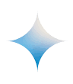
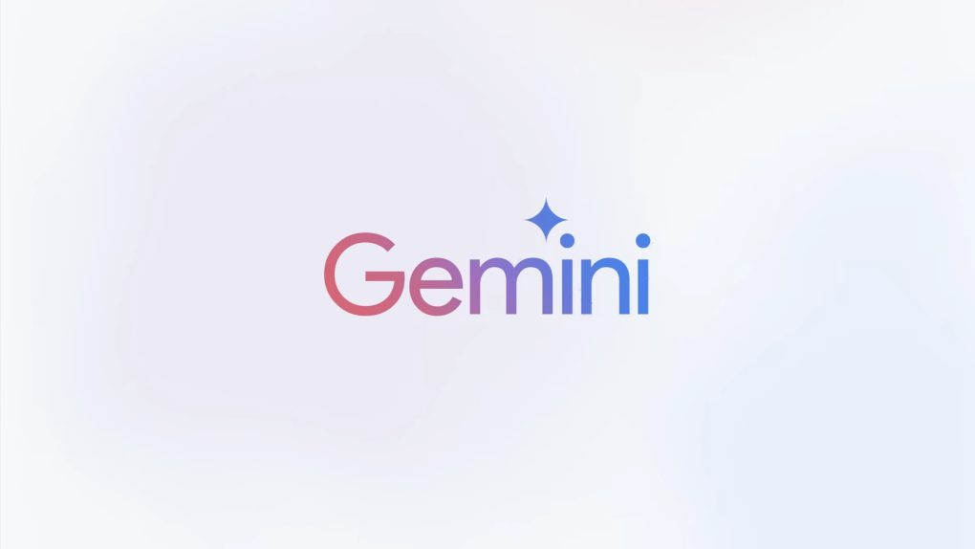


Major Gen AI Platforms
(Based on https://lmarena.ai/ rankings)
(OpenAI)
(Meta)
May 2024 GPT-4o - canvas (in beta) for collaboration - API used for many other AI apps
Dec 2024 o1 - “chain of thought” reasoning - advanced math / physics
Dec 2024 LLaMa 3.3 - open source and “open weight” - in Facebook, Messenger, Instagram, etc.
- code & weights used in many other AI’s - text-only input (text or image output)
(Mistral AI) Emphasis on free / open-source models
(Anthropic)
Oct 2024 3.5+ Sonnet - focus on ethics, alignment, safety - accuracy over creativity - does not train on user interactions - artifacts! agentic computer use!
- no web search / image generation
Nov 2024 Mistral / Pixtral / Codestral / Mathstral - canvas interface (like GPT-4o Pro) - web search (with citations)
(01.AI)
Oct 2024 Yi-Lightning - most powerful Chinese AI
(Google)
Sept 2024 1.5 Flash / Pro - targets research - includes some references (partner with OpenStax) - web search (with citations) - integrated with Google ecosystem
Nexusflow
(Nexusﬂow Solution)
Nov 2024 Athene-V2 - open source and “open weight”
(xAI)
Aug 2024 Grok 2 - creativity over accuracy

Slide 4
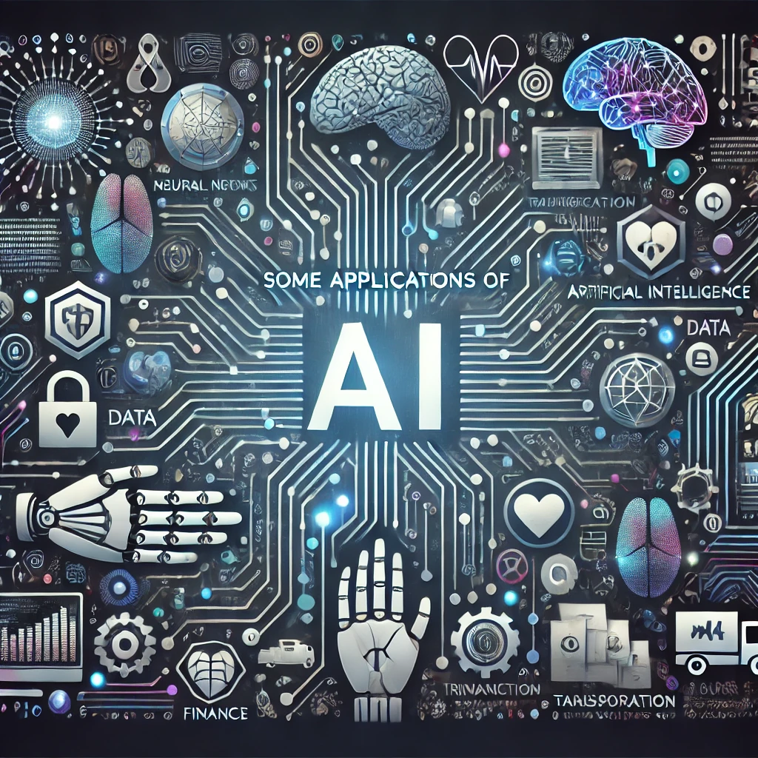
Some applications of artificial intelligence
Self-driving cars
Smart home devices
Virtual assistants
Fraud detection
Chemical research
Customer service
Weather forecasting
Market prediction
Recommendation systems
Facial / object recognition
Sentiment analysis
Speech / language translation
Voice-to-text (meeting / video captions)
Content summary
Content editing (text, computer code)
Content generation (text, images, video, audio, speech, code)
Content moderation (message boards, chats, online game interactions)
Personalized learning / tutoring
Help with instructor grading / feedback
Chatbot
Spam filtering
Network intrusion / virus detection
Sportscasting / commentating (e.g. Wimbledon)
Large language model (LLM) AI’s learn patterns in human created texts
Trained on extremely large datasets covering wide array of topics
Responses appear human-like, comprehensive, and researched
Can answer specific questions, generate ideas, summarize, translate, etc.

Slide 5
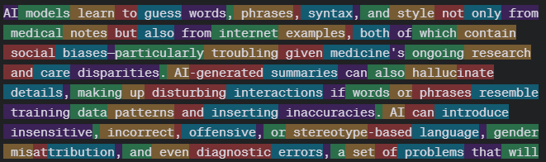
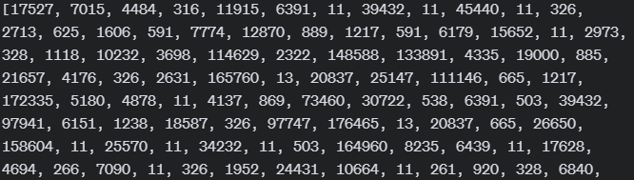
Rough Outline of Modern LLM (transformer AI)
tokenizer
Output of https://platform.openai.com/tokenizer
Prompt (image, text, audio)
Tokens (words, subwords, characters, pixels)
embedding
Vectors (numerical representation of meaning)
Aug 2024 context window for GPT-4o: 128,000 tokens
Embedding size of GPT-3 was about 12,000 dimensions
iterate
transformer
Next Token Prediction
Current top AI’s have over 1 trillion parameters
de-tokenizer
Response (image, text, audio)
Generated Output

Slide 6
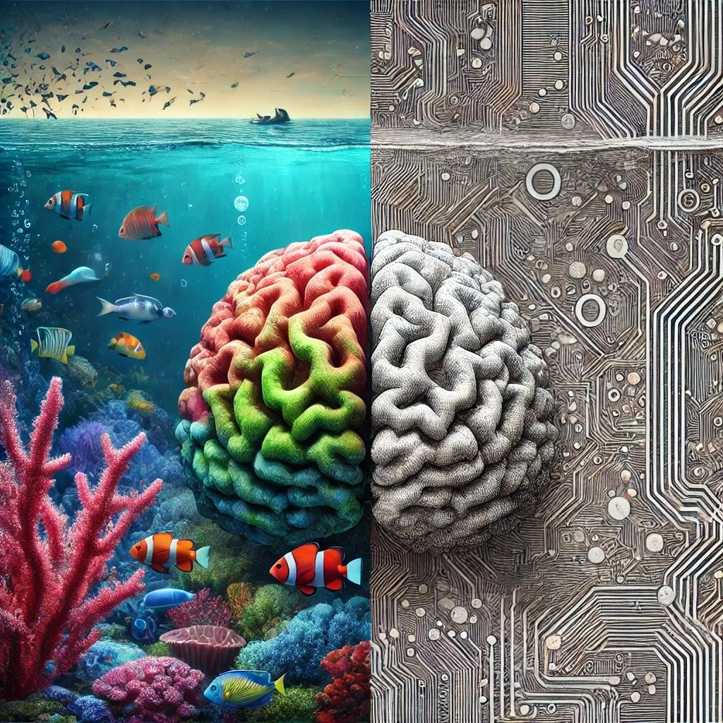

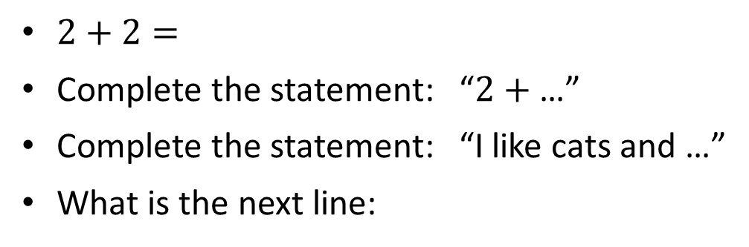
Expectations of AI vs Reality of AI
“Cloze probability”
“Semantic priming”
AI are not “computers”
ChatGPT views the following prompts similarly:
Not computational
Not deterministic
Not “garbage in – garbage out”
Not “does exactly what you tell it”
$2+2=$
Complete the statement: “$2+$ …”
Complete the statement: “I like cats and …”
What is the next line:
“Hey, I just met you, and this is crazy
But here’s my number …”
So call me, maybe?

Slide 7
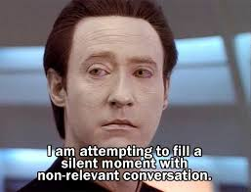
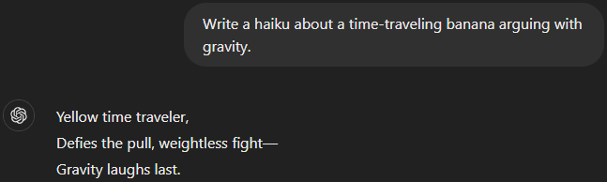
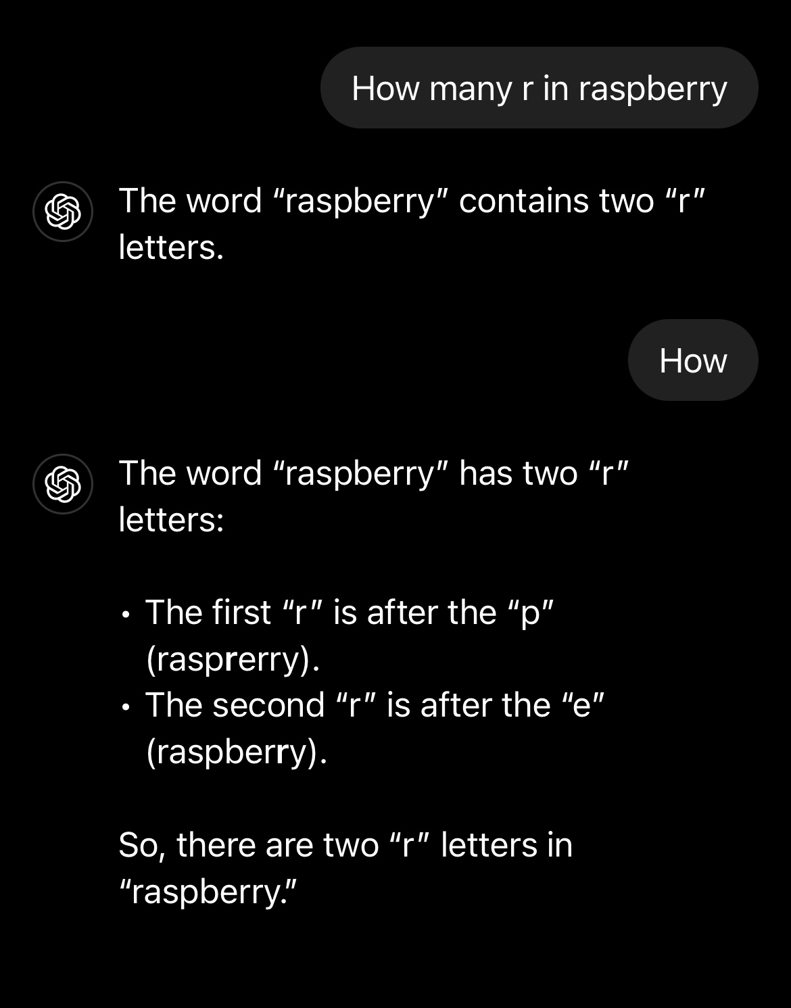
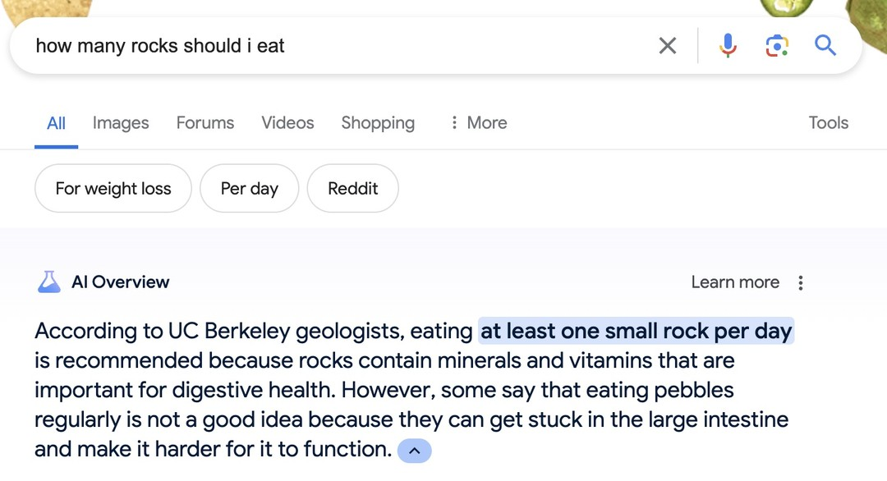

Expectations of AI vs Reality of AI
The AI we were told to expect…
The AI we were given…
ChatGPT, Dec 10, 2024
Star Trek: The Next Generation
OpenAI Developer’s forum, Aug 2024 “Incorrect count of ‘r’ characters…”
Google AI Overview (Gemeni), May 2024
I know now why you cry. But it is something I can never do.
Output may not always be accurate. You should not rely on Output from our Services as a sole source of truth or factual information, or as a substitute for professional advice.
You must evaluate Output for accuracy and appropriateness for your use case, including using human review as appropriate, before using or sharing Output from the Services.
- OpenAI terms of use
Terminator 2: Judgement Day

Slide 8

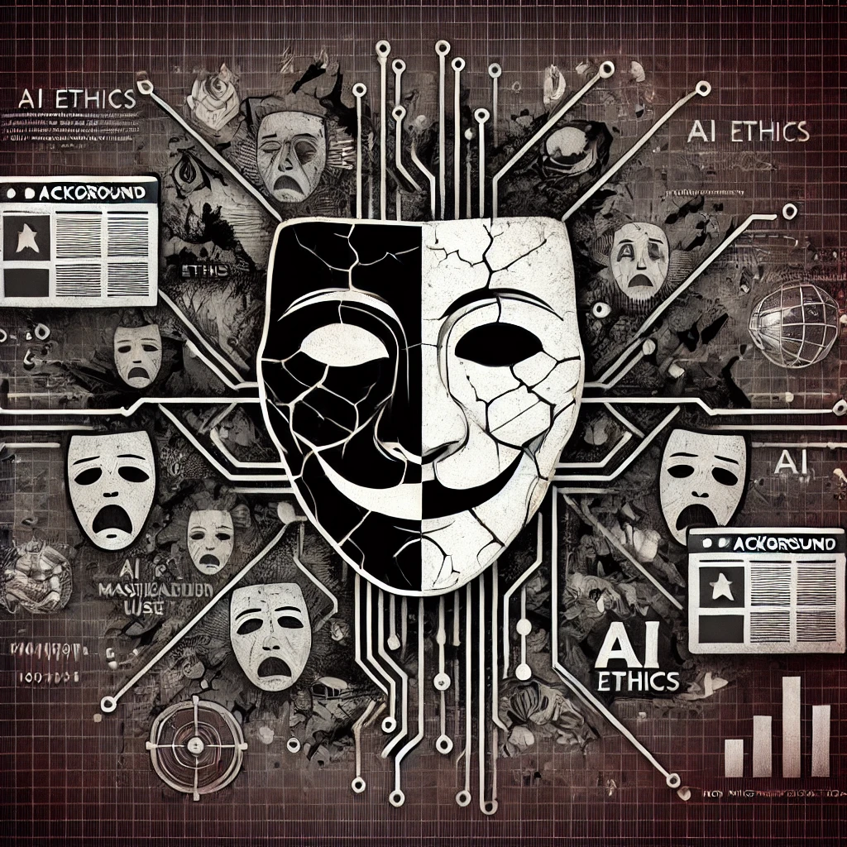
Some problems with artificial intelligences (LLM)
Issues with accuracy (though rapidly improving)
“Hallucination”
Lack / fabrication of references
Biases / gaps in training data
“Poisoning the well”
Proliferation of AI data corrupts future training
Causes decline in quantity and quality of human-generated content (and loss of expertise?)
→ artists, writers, programmers (stackoverflow)
Manipulation / Misinformation
Deep-fakes and the liar’s dividend
“Algorithmic radicalization” / “Rabbit-Hole effect” (via maximizing engagement)
Intentional misuse; see Costello et. al. “Debunkbot” (2024)
Hacking weights and features; see Templeton. Scaling monosemanticity… (2024) and Zehavi. Facial misrecognition systems… (2023)

Slide 9
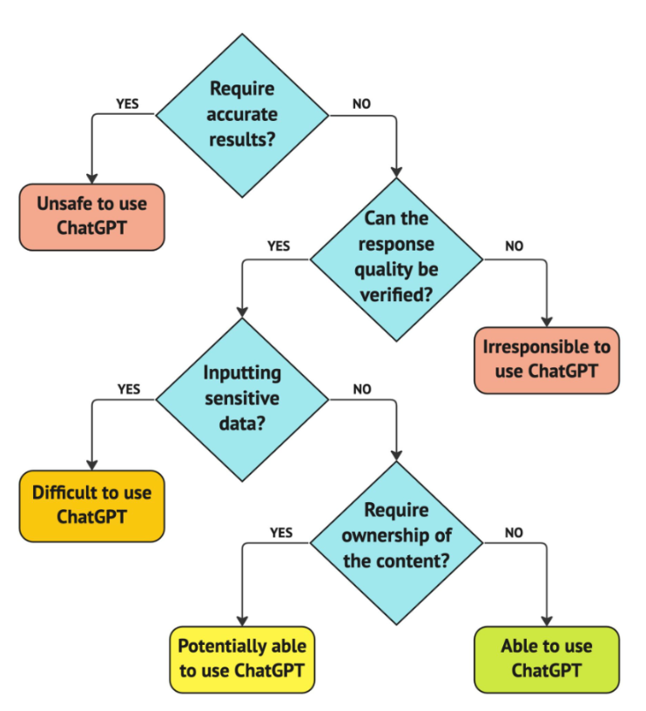

Slide 12

Privacy and surveillance
AI can be induced to leak training data. Massive training data sets can also be directly stolen or exposed via human intervention or mistakes.
Training data privacy Internal AI may be trained with confidential data; e.g. names, phone numbers, addresses, salary. Known attacks can extract this information. - see Nasr. Scalable extraction of training data… (2023)
Query data privacy Many AI will self-improve, training on supplied query or analysis data. Any non-anonymized data exposed to the AI is at risk of leakage. (Read AI???)
Social media scraping privacy See Cambridge Analytica scandal from 2018 (harvesting personal data from millions of users to influence politics).
Overcollection of data AI systems tend to collect extra data to maximize effectiveness; e.g. home assistant recording all video and audio.
Privacy of children See FTC lawsuit vs ByteDance due to collecting and hoarding data on minors (and impeding parental access).

Slide 13
Transparency and explainability
“Algorithmic collusion” ML driven high frequency trading may contribute to market volatility (2010). AI driven house price suggestions accused of price-fixing.

Slide 14
Accountability
“Blackout challenge” lawsuit vs TikTok? Aug 28. US appeals court revives lawsuit: ML recommendation engines “not protected by sec 230 of Communications Decency Act”
National security threat order (PAFACAA) vs ByteDance? TikTok collects data on US citizens, could be used to manipulate opinion?

Slide 15
Authorship rights
US copyright office gives NO ownership to any AI created content (all is public domain) See “Monkey Selfie” lawsuit and Zarya of the Dawn comic dispute.
Ownership of content. As between you and OpenAI, and to the extent permitted by applicable law, you (a) retain your ownership rights in Input and (b) own the Output. We hereby assign to you all our right, title, and interest, if any, in and to Output.
Similarity of content. Due to the nature of our Services and artificial intelligence generally, output may not be unique and other users may receive similar output from our Services. Our assignment above does not extend to other users’ output or any Third Party Output.
- OpenAI terms of use

Slide 16
“Human in the loop”
Automated ML decisions are dangerous!
Important for responsibility and accountability
Don’t blindly copy / believe AI output!
Don’t enter confidential data into 3rd party AI
Use AI to augment your creativity, not replace.
Think critically about likely training data and bias.

Slide 17

Policies

Slide 18
Some references
Nasr, M., Carlini, N., Hayase, J., Jagielski, M., Cooper, A. F., Ippolito, D., ... & Lee, K. (2023). Scalable extraction of training data from (production) language models. arXiv preprint arXiv:2311.17035.
Costello, T. H., Pennycook, G., & Rand, D. G. (2024). Durably reducing conspiracy beliefs through dialogues with AI. Science, 385(6714), eadq1814.
Templeton, A. (2024). Scaling monosemanticity: Extracting interpretable features from claude 3 sonnet. Anthropic.
https://transformer-circuits.pub/2024/scaling-monosemanticity/index.html
Zehavi, I., & Shamir, A. (2023). Facial misrecognition systems: Simple weight manipulations force dnns to err only on specific persons. arXiv preprint arXiv:2301.03118.

